Slide 1
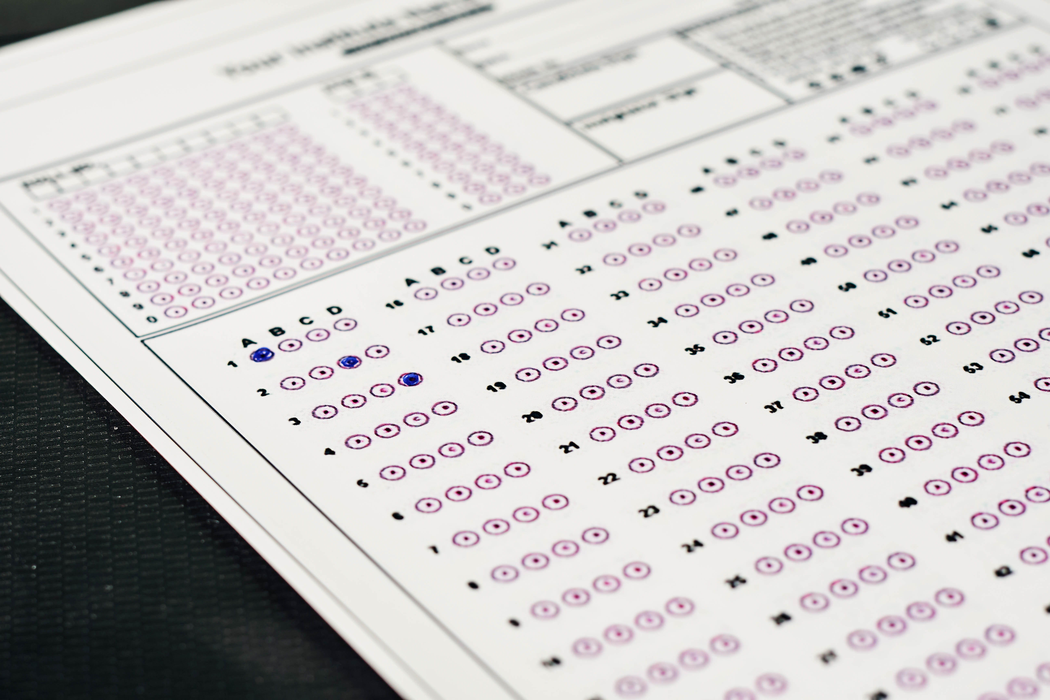
School District Testing Analysis
Josh Stephens
Hybrid Data Analyst
Creative Commons photo: https://www.flickr.com/photos/30478819@N08/51038121971
https://creativecommons.org/licenses/by/2.0/

Slide 2
Overview
Success metrics
Recommended next steps
Dataset analyzed

Slide 3
Success Metrics
Average math score
Average reading score
% passing math (≥ 70%)
% passing reading (≥ 70%)
% passing both

Slide 4
District Level Summary
Measure | Value
Total high schools | 15
Total students | 39,170
Total budget | $24,649,428
Mean math score | 79.0
Mean reading score | 81.9
% passing math | 75.0%
% passing reading | 85.8%
% passing both | 62.2%

Slide 5
Key finding
Charter school students outperformed district school students

Slide 6
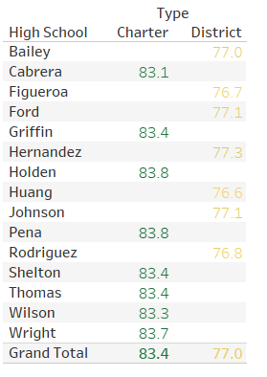
Mean math score by school type and school

